Slide 1
CSC6103 – Virtualization Techniques
Storage Virtualization
Prof. Yeh-Ching Chung
School of Data Science
Chinese University of Hong Kong, Shenzhen

Slide 2
Outline
Overview
  Introduction
  What to be virtualized
  Where to be virtualized
  How to be virtualized
Case study
  On linux system
    RAID
    LVM
    NFS
  In distributed system
    Vastsky
    Lustre
    Ceph
    HDFS

Slide 3
Overview
Introduction
What to be virtualized ?
  Block, File system
Where to be virtualized ?
  Host-based, Network-based, Storage-based
How to be virtualized ?
  In-band, Out-of-band

Slide 4
Storage Virtualization - introduction

Slide 5
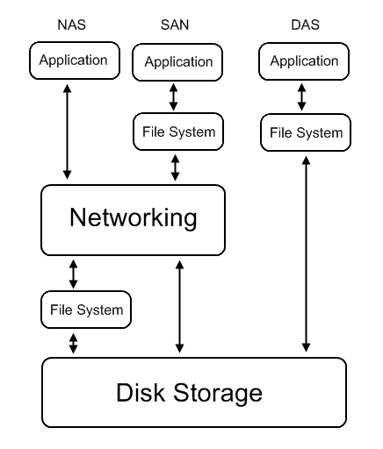
Introduction (1)
Common storage architecture
  DAS - Direct Attached Storage
    Storage device was directly attached to a server or workstation, without a storage network in between.
  NAS - Network Attached Storage
    File-level computer data storage connected to a computer network providing data access to heterogeneous clients.
  SAN - Storage Area Network
    Attach remote storage devices to servers in such a way that the devices appear as locally attached to the operating system.

Slide 6
Introduction (2)
Desirable properties of storage virtualization
  Manageability
    Storage resource should be easily configured and deployed.
  Availability
    Storage hardware failures should not affect the application.
  Scalability
    Storage resource can easily scale up and down.
  Security
    Storage resource should be securely isolated.

Slide 7
Introduction (3)
Storage concept and technique
  Storage resource mapping table
  Redundant data
  Multi-path
  Data sharing
  Tiering

Slide 8
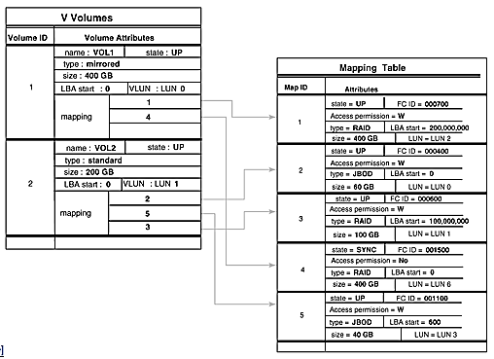
Concept and Technique (1)
Storage resource mapping table
  Maintain tables to map storage resource to target.
  Dynamic modify table entries for thin provisioning.
  Use table to isolate different storage address space.

Slide 9
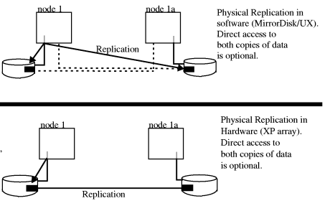
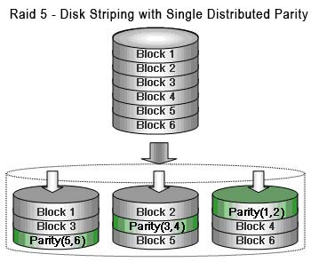
Concept and Technique (2)
Redundant data
  Maintain replicas to provide high availability.
  Use RAID technique to improve performance and availability.

Slide 10
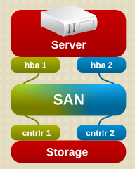
Concept and Technique (3)
Multi-path
  A fault-tolerance and performance enhancement technique.
  There is more than one physical path between the host and storage devices through the buses, controllers, switches, and bridge devices connecting them.

Slide 11
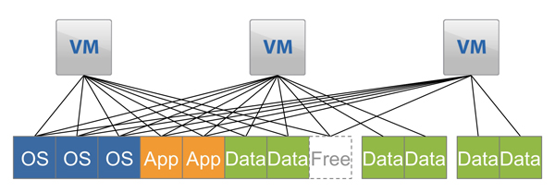
Concept and Technique (4)
Data sharing
  Use data de-duplication technique to eliminate duplicated data.
  Save and improve the usage of storage space

Slide 12
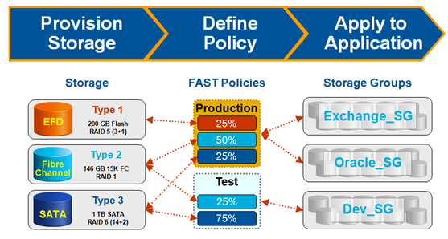
Concept and Technique (5)
Tiering
  Automatic migrate data across storage resources with different properties according to the significance or access frequency of data.
  Example: iMac fusion drive
Storage
Policies
Access Group

Slide 13
Storage Virtualization – What to be virtualized

Slide 14
What To Be Virtualized
Layers can be virtualized
  File system
    Provide compatible system call interface to user space applications.
  Block device
    Provide compatible block device interface to file system.
    Through the interface such as SCSI, SAS, ATA, SATA, etc.
User Space
Application
System call interface
Kernel Space
File System
Block interface
Device driver
Storage Device

Slide 15
File System Level (1)
Data and Files
  What is data
    Data is information that has been converted to a machine-readable, digital binary format.
    Control information indicates how data should be processed.
    Applications may embed control information in user data for formatting or presentation.
    Data and its associated control information is organized into discrete units as files or records.
  What is file
    Files are the common containers for user data, application code, and operating system executables and parameters.

Slide 16
File System Level (2)
About the files
  Metadata
    The control information for file management is known as metadata.
    File metadata includes file attributes and pointers to the location of file data content.
    File metadata may be segregated from a file's data content.
    Metadata on file ownership and permissions is used in file access.
    File timestamp metadata facilitates automated processes such as backup and life cycle management.
  Different file systems
    In Unix systems, file metadata is contained in the i-node structure.
    In Windows systems, file metadata is contained in records of file attributes.

Slide 17
File System Level (3)
File system
  What is file system
    A file system is a software layer responsible for organizing and policing the creation, modification, and deletion of files.
    File systems provide a hierarchical organization of files into directories and subdirectories.
    The B-tree algorithm facilitates more rapid search and retrieval of files by name.
    File system integrity is maintained through duplication of master tables, change logs, and immediate writes off file changes.
  Different file systems
    In Unix, the super block contains information on the current state of the file system and its resources.
    In Windows NTFS, the master file table contains information on all file entries and status.

Slide 18
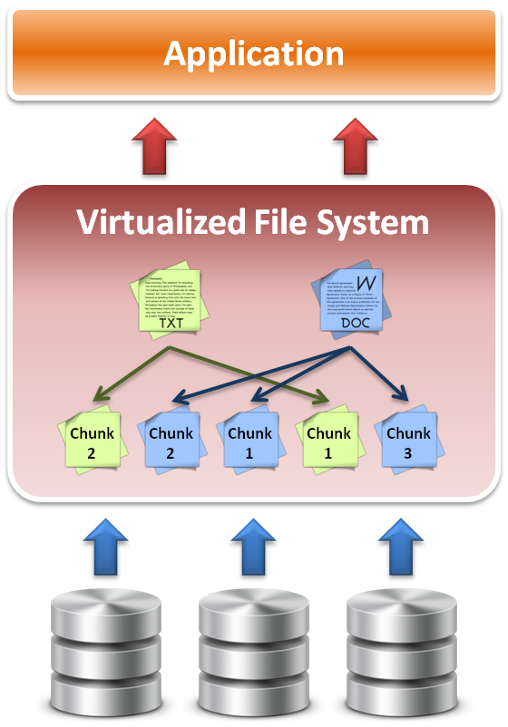
File System Level (4)
File system level virtualization
  File system maintains metadata (i-node) of each file.
  Translate file access requests to underlining file system.
  Sometime divide large file into small sub-files (chunks) for parallel access, which improves the performance

Slide 19
Block Device Level (1)
Block level data
  The file system block
    The atomic unit of file system management is the file system block.
    A file's data may span multiple file system blocks.
    A file system block is composed of a consecutive range of disk block addresses.
  Data in disk
    Disk drives read and write data to media through cylinder, head, and sector geometry.
    Microcode on a disk translates between disk block numbers and cylinder/head/sector locations.
    This translation is an elementary form of virtualization.

Slide 20
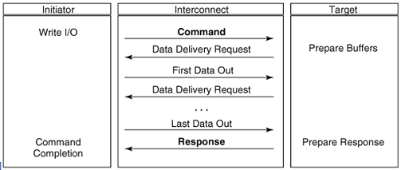
Block Device Level (2)
Block device interface
  SCSI (Small Computer System Interface)
    The exchange of data blocks between the host system and storage is governed by the SCSI protocol.
    The SCSI protocol is implemented in a client/server model.
    The SCSI protocol is responsible for block exchange but does not define how data blocks will be placed on disk.
    Multiple instances of SCSI client/server sessions may run concurrently between a server and storage.

Slide 21
Block Device Level (3)
Logical unit and Logical volume
  Logical unit
    The SCSI command processing entity within the storage target represents a logical unit (LU) and is assigned a logical unit number (LUN) for identification by the host platform.
    LUN assignment can be manipulated through LUN mapping, which substitutes virtual LUN numbers for actual ones.
  Logical volume
    A volume represents the storage capacity of one or more disk drives.
    Logical volume management may sit between the file system and the device drivers that control system I/O.
    Volume management is responsible for creating and maintaining metadata about storage capacity.
    Volumes are an archetypal form of storage virtualization.

Slide 22
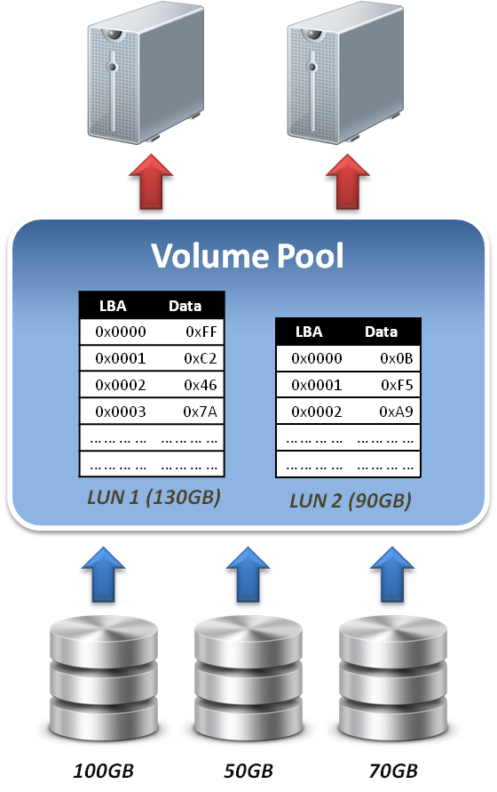
Block Device Level (4)
Data block level virtualization
  LUN & LBA
    A single block of information is addressed using a logical unit identifier (LUN) and an offset within that LUN, which known as a Logical Block Address (LBA).
  Apply address space remapping
    The address space mapping is between a logical disk and a logical unit presented by one or more storage controllers.

Slide 23
Storage Virtualization – Where to be virtualization

Slide 24
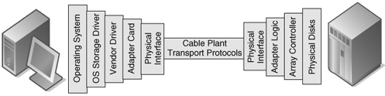
Where To Be Virtualized (1)
Storage interconnection
  The path to storage
    The storage interconnection provides the data path between servers and storage.
    The storage interconnection is composed of both hardware and software components.
    Operating systems provide drivers for I/O to storage assets.
    Storage connectivity for hosts is provided by host bus adapters (HBAs) or network interface cards (NICs).

Slide 25
Where To Be Virtualized (2)
Storage interconnection protocol
  Fibre Channel
    Usually for high performance requirements.
    Supports point-to-point, arbitrated loop, and fabric interconnects.
    Device discovery is provided by the simple name server (SNS).
    Fibre Channel fabrics are self-configuring via fabric protocols.
  iSCSI ( internet SCSI )
    For moderate performance requirements.
    Encapsulates SCSI commands, status and data in TCP/IP.
    Device discovery by the Internet Storage Name Service (iSNS).
    iSCSI servers can be integrated into Fibre Channel SANs through IP storage routers.

Slide 26
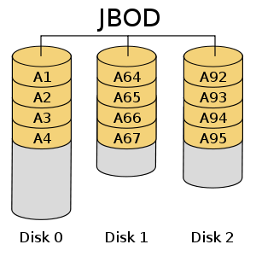
Where To Be Virtualized (3)
Abstraction of physical storage
  Physical to virtual
    The cylinder, head and sector geometry of individual disks is virtualized into logical block addresses (LBAs).
    For storage networks, the physical storage system is identified by a network address / LUN pair.
    Combining RAID and JBOD assets to create a virtualized mirror must accommodate performance differences.
  Metadata integrity
    Storage metadata integrity requires redundancy for failover or load balancing.
    Virtualization intelligence may need to interface with upper layer applications to ensure data consistency.

Slide 27
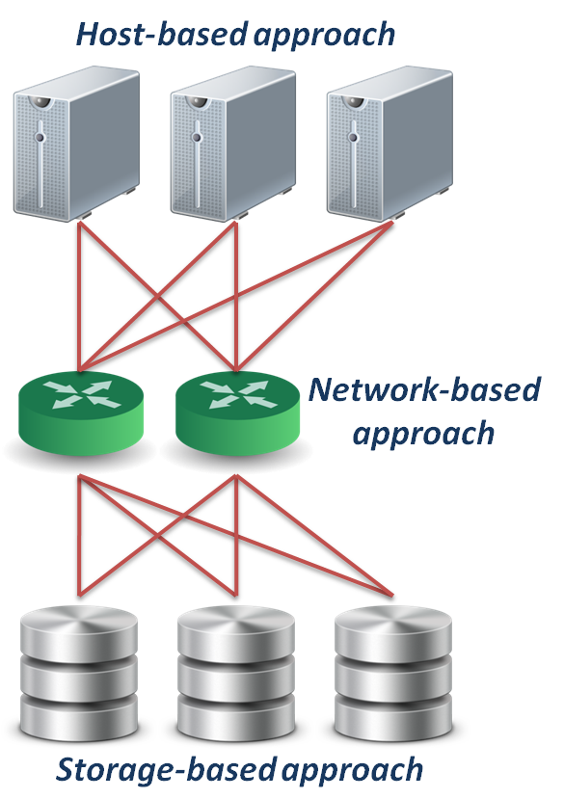
Where To Be Virtualized (4)
Different approaches
  Host-based approach
    Implemented as a software running on host systems.
  Network-based approach
    Implemented on network devices.
  Storage-based approach
    Implemented on storage target subsystem.

Slide 28


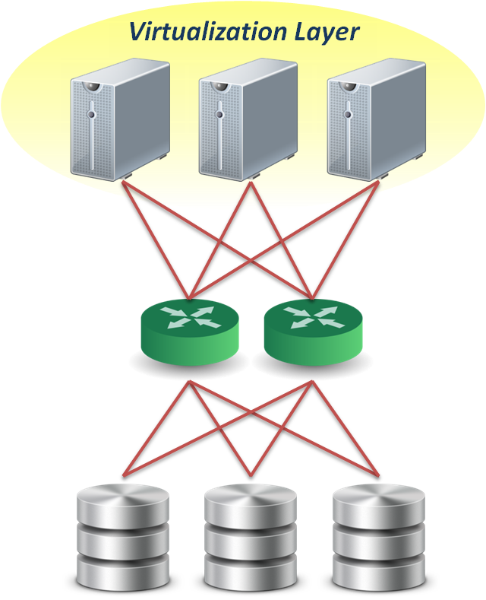
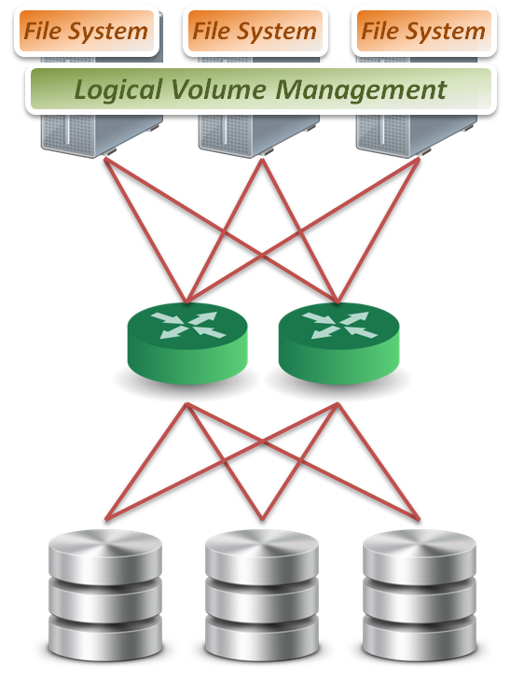
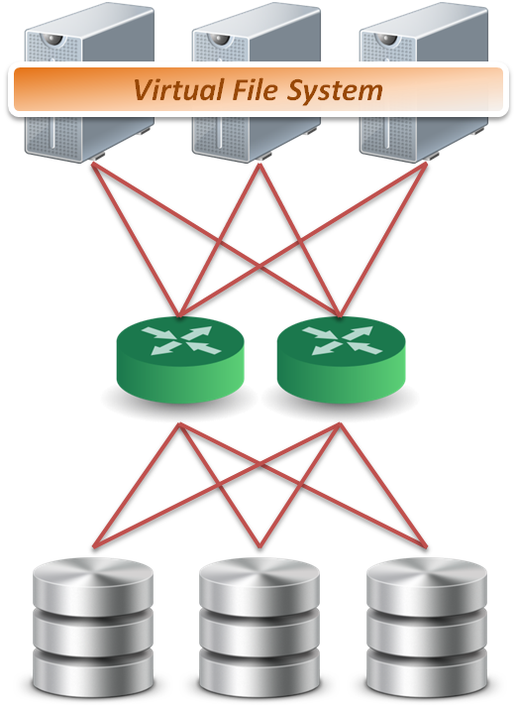

Host-Based Virtualization (1)
Host-based approach
  File level
    Run virtualized file system on the host to map files into data blocks, which distributed among several storage devices.
  Block level
    Run logical volume management software on the host to intercept I/O requests and redirect them to storage devices.
  Provide services
    Software RAID
Block 1
Block 2
Block 1
Block 2
Block 1
Sub-file
1
Sub-file
2
Sub-file
3

Slide 29
Host-Based Virtualization (2)
Important issues
  Storage metadata servers
    Storage metadata may be shared by multiple servers.
    Shared metadata enables a SAN file system view for multiple servers.
    Provides virtual to real logical block address mapping for client.
    A distributed SAN file system requires file locking mechanisms to preserve data integrity.
  Host-based storage APIs
    May be implemented by the operating system to provide a common interface to disparate virtualized resources.
    Microsoft's virtual disk service (VDS) provides a management interface for dynamic generation of virtualized storage.

Slide 30
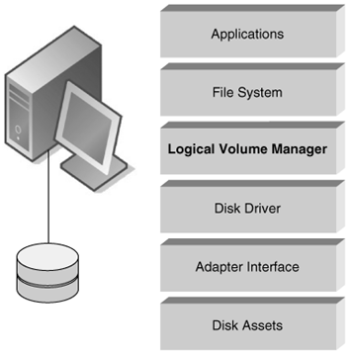
Host-Based Virtualization (3)
A typical example
  LVM
    Software layer between the file system and the disk driver.
    Executed by the host CPU.
    Lack hardware-assist for functions such as software RAID.
    Independence from vendor-specific storage architectures.
    Dynamic capacity allocation to expand or shrink volumes.
    Support alternate path for high availability.

Slide 31
Host-Based Virtualization (4)
Host-based implementation
  Pros
    No additional hardware or infrastructure requirements
    Simple to design and implement
    Improve storage utilization
  Cons
    Storage utilization optimized only on a per host base
    Software implementation is dependent to each operating system
    Consume CPU clock cycle for virtualization
  Examples
    LVM, NFS

Slide 32

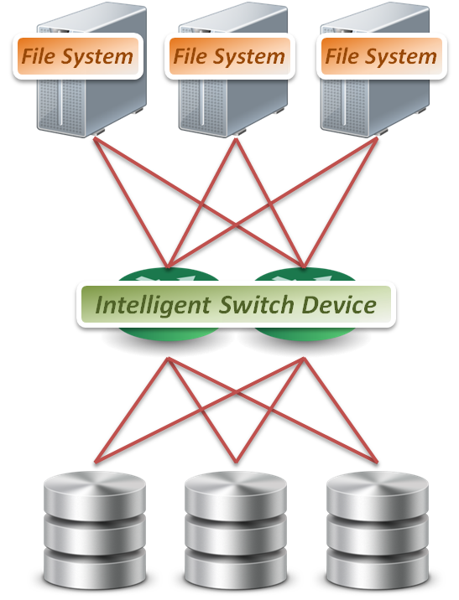
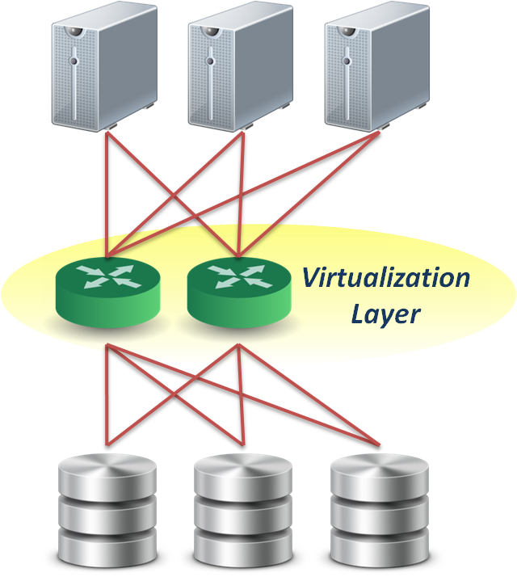
Network-Based Virtualization (1)
Network-based approach
  File level
    Seldom implement file level virtualization on network device.
  Block level
    Run software on dedicated appliances or intelligent switches and routers.
  Provide services
    Multi-path
    Storage pooling
Block 1
Block 2
Block 1
Block 2
Block 1

Slide 33
Network-Based Virtualization (2)
Requirements of storage network
  Intelligent services
    Logon services
    Simple name server
    Change notification
    Network address assignment
    Zoning
  Fabric switch should provide
    Connectivity for all storage transactions
    Interoperability between disparate servers,
    operating systems, and target devices

Slide 34
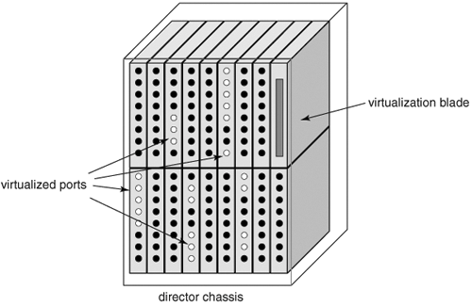
Network-Based Virtualization (3)
Techniques for fabric switch virtualization
  Hosted on departmental switches
    A PC engine provisioned as an option blade.
  Data center directors
    Should be able to preserve the five nines availability characteristic of director-class switches.
    Dedicated virtualization ASICs provide
    high-performance frame processing
    and block address mapping.
  Interoperability between different implementations will become a priority.

Slide 35
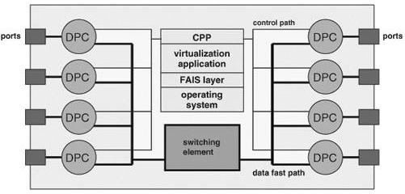
Network-Based Virtualization (4)
Interoperability issue
  FAIS ( Fabric Application Interface Standard )
    Define a set of standard APIs to integrate applications and switches.
    FAIS separates control information and data paths.
    The control path processor (CPP) supports the FAIS APIs and upper layer storage virtualization application.
    The data path controller (DPC) executes the virtualized SCSI I/Os under the management of one or more CPPs

Slide 36
Network-Based Virtualization (5)
Network-based implementation
  Pros
    True heterogeneous storage virtualization
    No need for modification of host or storage system
    Multi-path technique improve the access performance
  Cons
    Complex interoperability matrices - limited by vendors support
    Difficult to implement fast metadata updates in switch device
    Usually require to build specific network equipments (e.g., Fibre Channel)
  Examples
    IBM SVC ( SAN Volume Controller ), EMC Invista

Slide 37

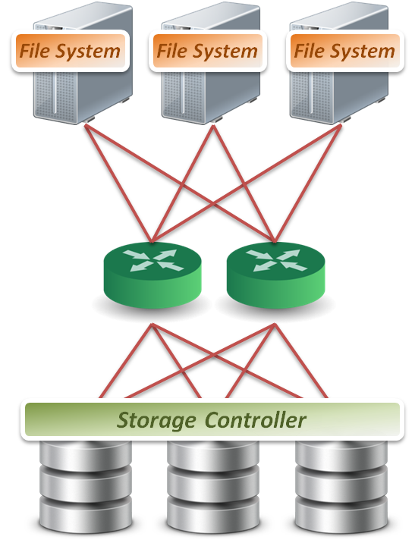
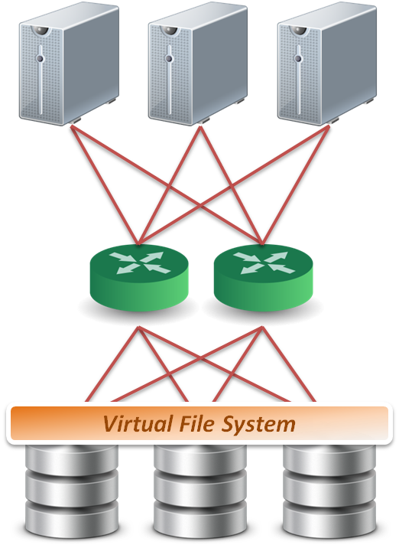
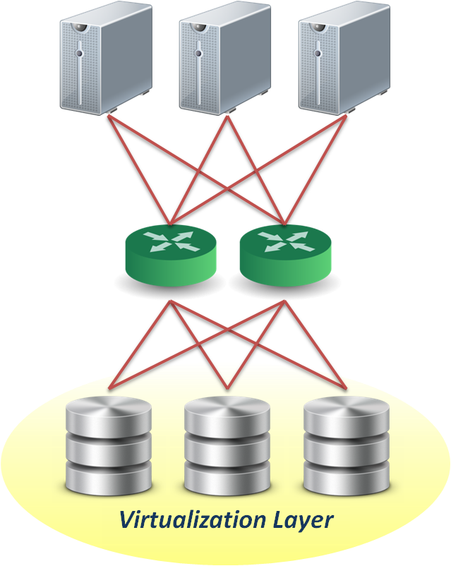
Storage-Based Virtualization (1)
Storage-based approach
  File level
    Run software on storage device to provide file based data storage services to host through network.
  Block level
    Embeds the technology in the target storage devices.
  Provide services
    Storage pooling
    Replication and RAID
    Data sharing and tiering
Block 1
Block 1
Block 1
Replica
Replica
Replica
Block 1
Block 1
Block 1
Sub-file
1
Sub-file
1.bak
Sub-file
2
Sub-file
2.bak
Sub-file
3

Slide 38
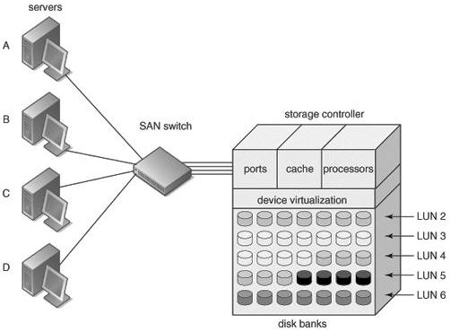
Storage-Based Virtualization (2)
Array-based virtualization
  Storage controller
    Provide basic disk virtualization in the form of RAID management, mirroring, and LUN mapping or masking.
    Allocate a single LUN to multiple servers.
    Offer Fibre Channel, iSCSI, and SCSI protocol.
  Cache memory
    Enhance performance.
  Storage assets coordination
    Coordination between multiple storage systems is necessary to ensure high availability.

Slide 39
Storage-Based Virtualization (3)
Data replication
  Array-based data replication
    Referred to as disk-to-disk replication.
    Requires that a storage controller function concurrently as both an initiator and target.
  Synchronous vs. Asynchronous
    Synchronous data replication ensures that a write operation to a secondary disk array is completed before the primary array acknowledges task completion to the server.
    Asynchronous data replication provides write completion by the primary array, although the transaction may still be pending to the secondary array.

Slide 40
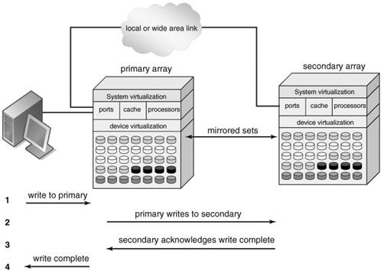
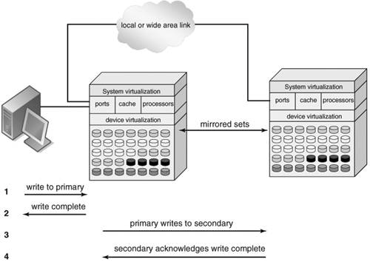
Storage-Based Virtualization (4)
Synchronous
Asynchronous
To preserve performance, synchronous data replication is limited to metropolitan distances
Asynchronous data replication is largely immune to transmission latency

Slide 41
Storage-Based Virtualization (5)
Other features
  Point-in-time copy (snapshot)
    Provide point-in-time copies of an entire storage volume.
    Snapshot copies may be written to secondary storage arrays.
    Provide an efficient means to quickly recover a known good volume state in the event of data from the host.
  Distributed modular virtualization
    Decoupling storage controller logic from physical disk banks provides flexibility for supporting heterogeneous disk assets and facilitates distributed virtualization intelligence.
    Accommodates class of storage services and data lifecycle management.

Slide 42
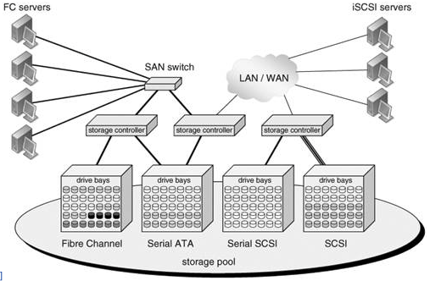
Storage-Based Virtualization (6)
Distributed Modular Virtualization
  Decoupling storage controller intelligence and virtualization engines from physical disk banks facilitates multi-protocol block data access and accommodation of a broad range of disk architectures.

Slide 43
Storage-Based Virtualization (7)
Storage-based implementation
  Pros
    Provide most of the benefits of storage virtualization
    Reduce additional latency to individual IO
  Cons
    Storage utilization optimized only across the connected controllers
    Replication and data migration only possible across the connected controllers and the same vendors devices
  Examples
    Disk array products

Slide 44
Storage Virtualization - How to be virtualized

Slide 45
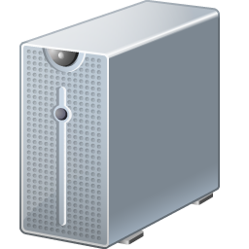

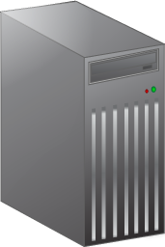

In-Band Virtualization
Implementation methods
  In-band
    Also known as symmetric, virtualization devices actually sit in the data path between the host and storage.
    Hosts perform IO to the virtualized device and never interact with the actual storage device.
  Pros
    Easy to implement
  Cons
    Bad scalability & Bottle neck
Control
Message
Control
Message
Control
Message
Control
Message
Control
Message
Control
Message
Data
Data
Data

Slide 46
Out-of-Band Virtualization
Implementation methods
  Out-of-band
    Also known as asymmetric, virtualization devices are sometimes called metadata servers.
    Require additional software in the host which knows the first request location of the actual data.
  Pros
    Scalability & Performance
  Cons
    Hard to implement
Control
Message
Control
Message
Control
Message
Control
Message
Control
Message
Control
Message
Data
Data
Data

Slide 47
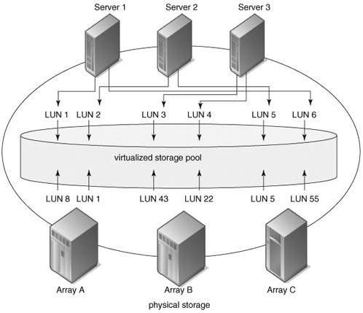
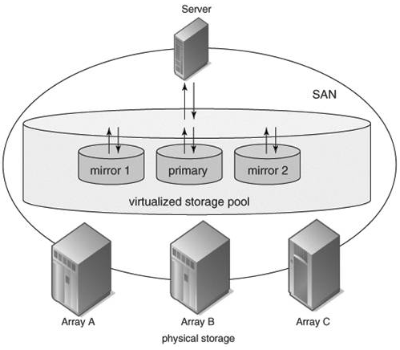
Other Virtualization Services (1)
Pooling Heterogeneous
Storage Assets
Heterogeneous Mirroring
In a virtualized storage pool, virtual assets may be dynamically resized and allocated to servers by drawing on the total storage capacity of the SAN
Heterogeneous mirroring offers more flexible options than conventional mirroring, including three-way mirroring within storage capacity carved from different storage systems

Slide 48
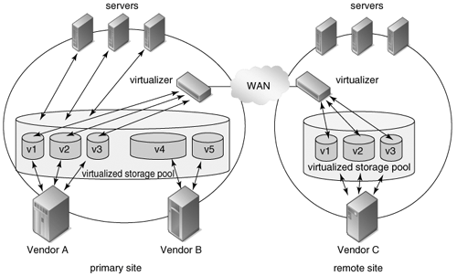
Other Virtualization Services (2)
Heterogeneous Data Replication
Heterogeneous data replication enables duplication of storage data between otherwise incompatible storage systems.

Slide 49
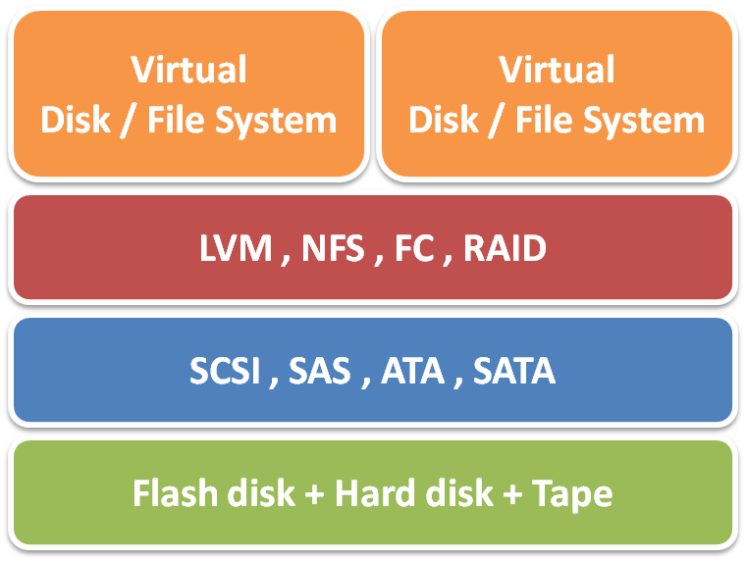
Summary
Storage virtualization technique
  Virtualization layer
    File level and block level
  Virtualization location
    Host, network and storage base
  Virtualization method
    In-band and out-of-band
Storage virtualization services
  Storage pooling and sharing
  Data replication and mirroring
  Snapshot and multi-pathing

Slide 50
Storage Virtualization – case study

Slide 51
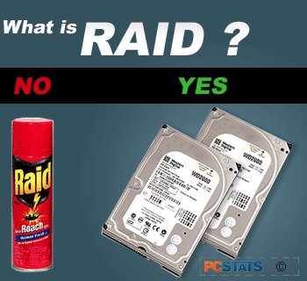
RAID
RAID (redundant array of independent disks)
  Originally: redundant array of inexpensive disks
  RAID schemes provide different balance between the key goals:
    Reliability
    Availability
    Performance
    Capacity

Slide 52
RAID level (1)
The most used
  RAID0
    block-level striping without parity or mirroring
  RAID1
    mirroring without parity or striping
  RAID1+0
    referred to as RAID 1+0, mirroring and striping

Slide 53
RAID level (2)
The most used
  RAID2
  RAID3
  RAID4
  RAID5
    Block-level striping with distributed parity
  RAID5+0
    Referred to as RAID 5+0, distributed parity and striping
  RAID6

Slide 54
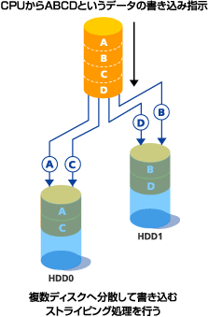
RAID 0
RAID 0: Block-level striping without parity or mirroring
  It has no (or zero) redundancy.
  It provides improved performance and additional storage
  It has no fault tolerance. Any drive failure destroys the array, and the likelihood of failure increases with more drives in the array.

Slide 55
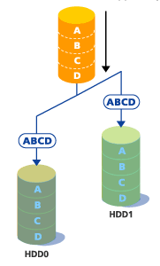
RAID 1
RAID 1: Mirroring without parity or striping
  Data is written identically to two drives, thereby producing a "mirrored set";
  A read request is serviced by one of the two drives containing with least seek time plus rotational latency.
  A write request updates the stripes of both drives. The write performance depends on the slower of the two.
  At least two drives are required to constitute such an array.
  The array continues to operate as long as at least one drive is functioning.
Space efficiency
  1 / N
    N = 2
Fault tolerance
  N – 1
    N = 2

Slide 56
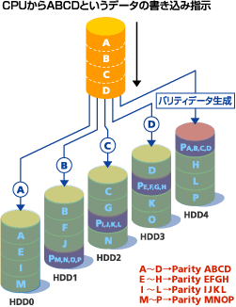
RAID 5
RAID5: Block-level striping with distributed parity
  distributes parity on different disk
  requires at least 3 disks
Space efficiency
  1 − 1/N
Fault tolerance
  1

Slide 57
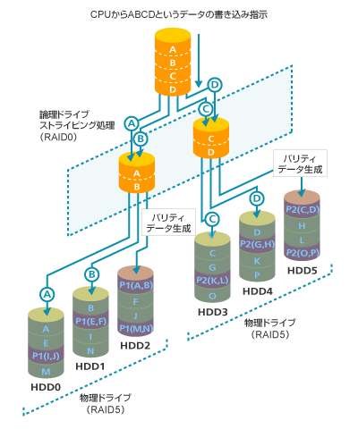
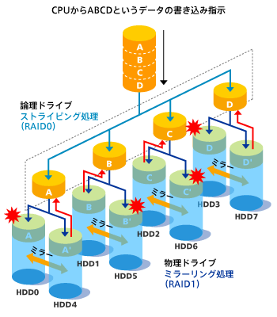
RAID 1+0 / RAID 5+0
RAID 1+0
RAID1(mirror) + Stripe
RAID 5+0
RAID5(parity) + Stripe

Slide 58
RAID Level Comparison
RAID level | Reliability | Write Performance | Space efficiency
RAID 0 | × | ○ | 2/2
RAID 1 | ◎ | ○ | 1/2
RAID 1+0 | ◎ | ○ | 2/4
RAID 5 | ○ | △ | 2/3
RAID 5+0 | ○ | ○ | 4/6

Slide 59
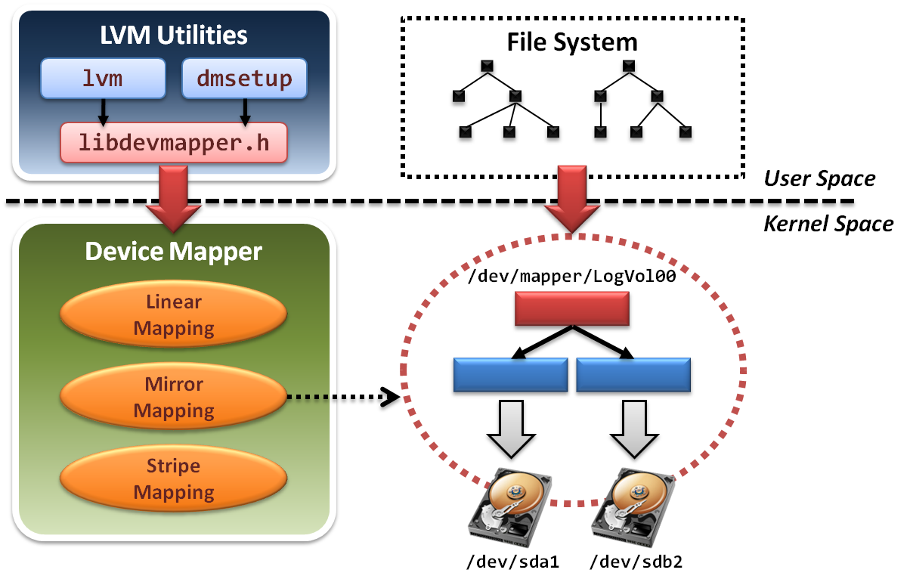
Logical Volume Management (1)
LVM architecture

Slide 60
Logical Volume Management (2)
LVM project is implemented in two components
  In user space
    Some management utilities and configuration tools
    Ex. lvm , dmsetup
    Programming interface with a well-designed library
    Ex. libdevmapper.h
  In kernel space
    Implement device mapper framework
    Provide different mapped device targets
    Ex. linear , stripe , mirror …etc.

Slide 61
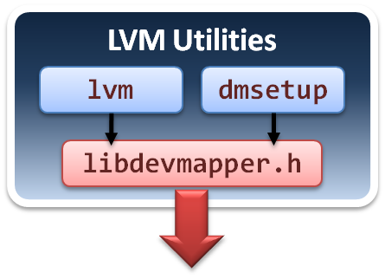
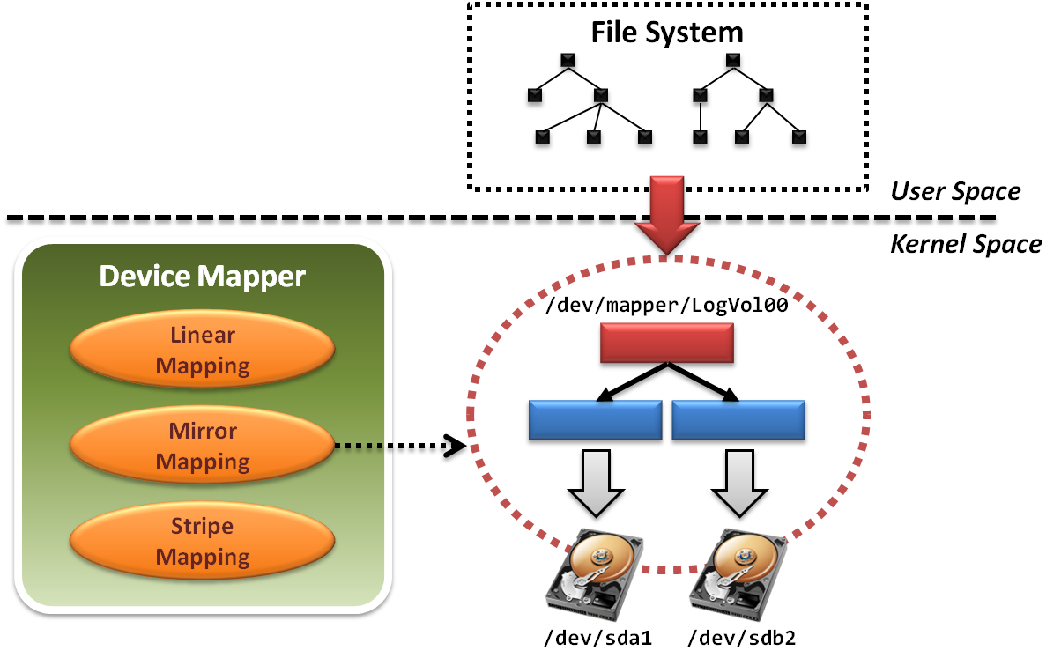
Logical Volume Management (3)
Tools and utilities are in user space.

Slide 62
Logical Volume Management (4)
lvm
  Command-line tools for LVM2.
    logical volume ( lv ) operations
    volume group ( vg ) operations
    physical volume ( pv ) operations
  Limited controllability
    Only can create logical volume with simple mapping mechanisms.
    Do not allow cross machine mappings.
dmsetup
  Limitations
    Still cannot provide cross machine mappings.

Slide 63
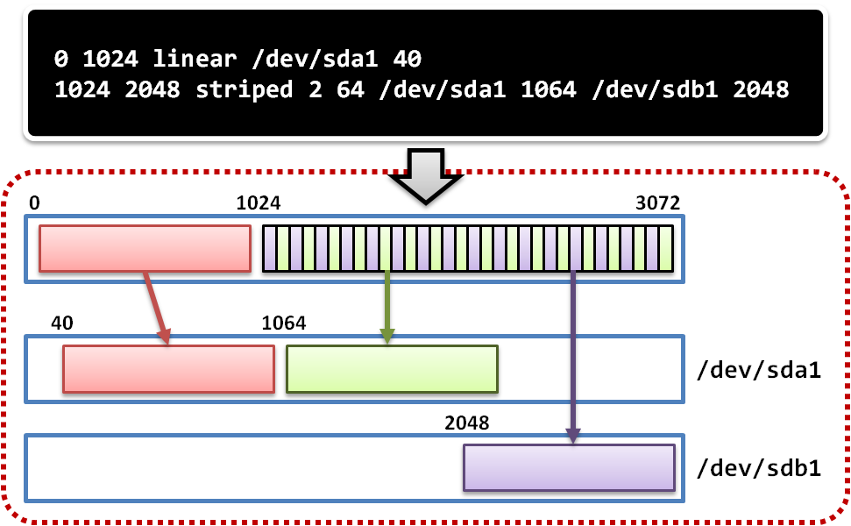
Logical Volume Management (5)
dmsetup
  Low level logical volume management
    Operate create, delete, suspend and resume …etc
    Work with mapping table file

Slide 64
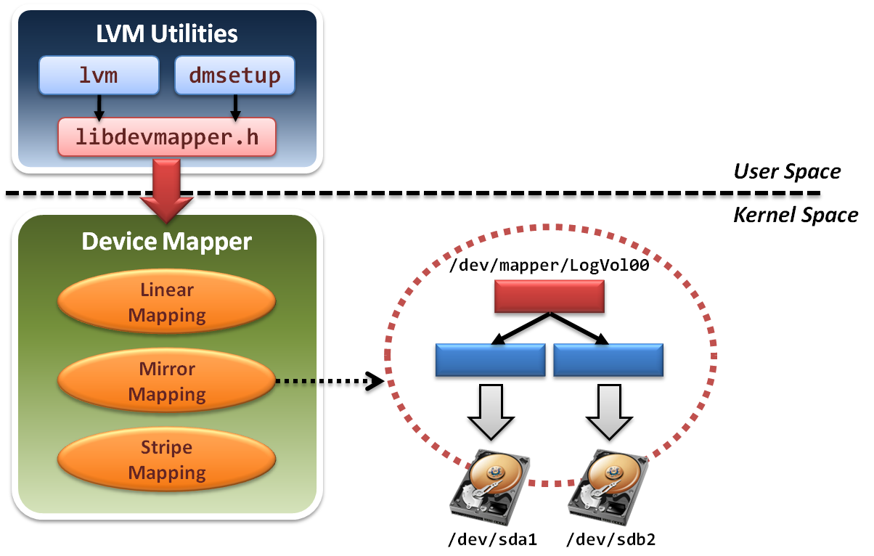
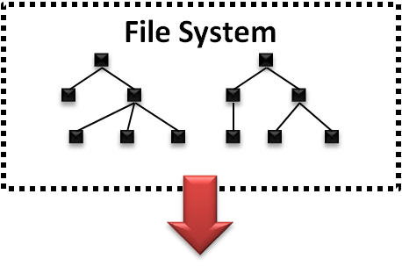
Logical Volume Management (6)
File system will build upon device mapper framework by means of system calls.

Slide 65
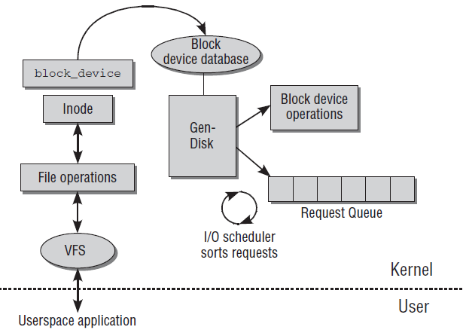
Logical Volume Management (7)
File system in operating system will invoke a set of block device system calls.
Device Mapper framework
reload operation functions

Slide 66
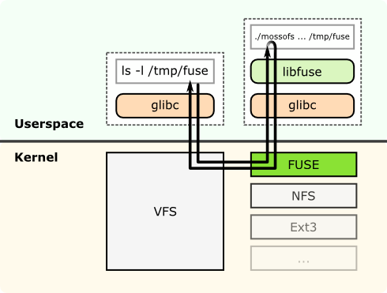
Logical Volume Management (8)
File system can be also implemented in the user space only.

Slide 67
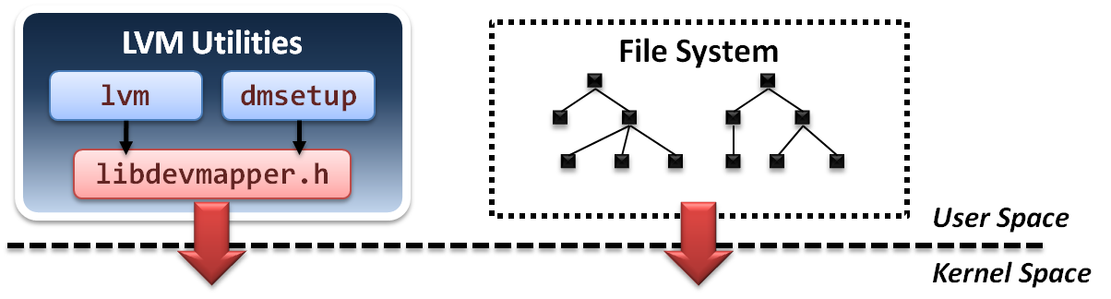
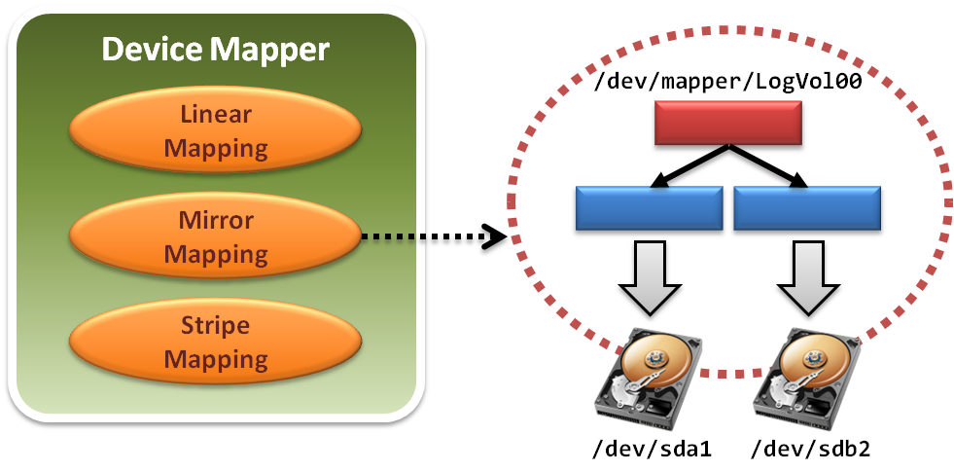
Logical Volume Management (9)
Device mapper framework implements a Linux kernel driver for different mappings.

Slide 68
Logical Volume Management (10)
Device mapper framework defines a set of target device mapping interfaces.
  dm_ctr_fn ctr
    Initiator of each newly created mapped device
  dm_dtr_fn dtr
    Destructor of each removing mapped device
  dm_map_fn map
    Setup the mapping relations
  dm_ioctl_fn ioctl
    Exactly perform system IO invocations
  … etc.

Slide 69

Logical Volume Management (11)
Develop a new mapped device target and add it into device mapper framework.
  Improve scalability

Slide 70

Network File System (1)
NFS architecture

Slide 71
Network File System (2)
What is NFS
  NFS is a POSIX-compliant distributed file system
    Work distributedly as server-client model
  NFS builds on the Remote Procedure Call (RPC) system.
  The Network File System is an open standard defined in RFCs.
Some features
  Shared POSIX file system
  Common module in linux kernel
  well performance

Slide 72

Network File System (3)
Dynamic Port and its handle
  In NFSv3, service listens on random tcp port.
  NFS use RPC(Remote Procedure Call) to get the port of service.

Slide 73

Network File System (4)
Consistency and concurrency in NFS
  Lockd offers a write lock to handle concurrent update.
  Statd handles the consistency between server and clients.

Slide 74
Storage Virtualization in distributed system
Case-study, virtualization in distributed system
  Block-based
    VastSky
  File-based
    Lustre
  Object-based
    Ceph
    HDFS

Slide 75
VastSky (1)
Overview
  VastSky is a linux-based cluster storage system, which provides logical volumes to users by aggregating disks over a network.
Three kinds of servers
  Storage manager
    Maintaining a database which describes physical and logical resources in a system.
    e.g. create and attach logical volumes.
  Head servers
    Running user applications or virtual machines which actually use VastSky logical volumes.
  Storage servers
    Storage servers have physical disks which are used to store user data.
    They are exported over the network and used to provide logical volumes on head servers. (iSCSI)

Slide 76


VastSky (2)
VastSky Architecture
XML-RPC
Storage
Manager
iSCSI request
XML-RPC
Storage Pool

Slide 77
VastSky (3)
Logical Volume
  a set of several mirrored disks
  several physical disk chunks on different servers
Storage Pool
Logical Volume
Storage
Server1
Storage
Server2
There are 3 mirrored disks
and all of them are distributed
in 3 different servers.
Storage
Server3
Storage
Server4

Slide 78
VastSky (4)
Redundancy
  VastSky mirrors user data to three storage servers by default and all of them are updated synchronously.
  VastSky can be configured to use two networks (e.g. two independent ethernet segments) for redundancy.
Fault detection
  The storage manager periodically checks if each head and storage servers are responsive.
Recovery
  On a failure, the storage manager attempts to reconfigure mirrors by allocating new extents from other disks automatically.

Slide 79
VastSky (5)
Recovery Mechanism
Storage Pool
Storage
Server1
Logical Volume
Recovering
Storage
Server2
data
1st Network
Attach
Attach
spare
Storage
Server3
crash
Attach
data
Copy
2nd Network
Storage
Server4
data

Slide 80
VastSky (6)
Scalability
  Most of cluster file-systems and storage systems which have a meta-data control node have a scalability problem.
  VastSky doesn't have this problem since once a logical volume is set up, all I/O operations will be done only through Linux drivers without any storage manager interactions.

Slide 81
VastSky (7)
Load Balance
  With VastSky's approach, the loads will be equalized across the physical disks, which leads that it utilizes the I/O bandwidth of them.
Logical Volume
Storage Pool
D1
D2
D3
Storage
Server1
D2
D1
D3
D1
D3
D2
D2
D1
D1
D1
D1
D3
Storage
Server2
D2
D2
D1
D3
D1
D3
D2
D3
D1
D3
D3
Storage
Server3
D2
D1
D1
D1
D3
D2
D2
D2
D3
D3
D1
D2
D1
D2
Storage
Server4
D2
D3
D3
D2
D3
D2
D1
D3

Slide 82

Lustre File System (1)
What is Lustre ?
  Lustre is a POSIX-compliant global, distributed, parallel file system.
  Lustre is licensed under GPL.
Some features :
  Parallel shared POSIX file system
  Scalable
    High performance
    Petabytes of storage
  Coherent
    Single namespace
    Strict concurrency control
  Heterogeneous networking
  High availability

Slide 83
Lustre File System (2)
Lustre components
  Metadata Server (MDS)
    The MDS server makes metadata stored in one or more MDTs.
  Metadata Target (MDT)
    The MDT stores metadata (such as filenames, permissions) on an MDS.
  Object Storage Servers (OSS)
    The OSS provides file I/O service, and network request handling for one or more local OSTs.
  Object Storage Target (OST)
    The OST stores file data as data objects on one or more OSSs.

Slide 84
Lustre File System (3)
Lustre network
  Supports several network types
    Infiniband, TCP/IP on Ethernet, Myrinet, Quadrics, …etc.
  Take advantage of remote direct memory access (RDMA)
    Improve throughput and reduce CPU usage

Slide 85

Lustre File System (4)

Slide 86

Lustre File System (5)
Lustre in HPC
  Lustre is the leading HPC file system
    15 of Top 30
    Demonstrated scalability
  Performance
    Systems with over 1,000 nodes
    190 GB/sec IO
    26,000 clients
  Examples
    Titan supercomputer at Oak Ridge National Laboratory
      TOP500: #1, November 2012
    System at Lawrence Livermore National Laboratory (LLNL)
    Texas Advanced Computing Center (TACC)

Slide 87

Ceph (1)
Overview
  Ceph is a free software distributed file system.
  Ceph's main goals are to be POSIX-compatible, and completely distributed without a single point of failure.
  The data is seamlessly replicated, making it fault tolerant.
Release
  On July 3, 2012, the Ceph development team released Argonaut, the first release of Ceph with long-term support.

Slide 88
Ceph (2)
Introduction
  Ceph is a distributed file system that provides excellent performance ,reliability and scalability.
  Objected-based Storage.
  Ceph separates data and metadata operations by eliminating file allocation tables and replacing them with generating functions.
  Ceph utilizes a highly adaptive distributed metadata cluster, improving scalability.
  Using object-based storage device (OSD) to directly access data, high performance.

Slide 89

Ceph (3)
Objected-Based Storage

Slide 90
Ceph (4)
Goal
  Scalability
    Storage capacity, throughput, client performance
    Emphasis on HPC
  Reliability
    Failures are the norm rather than the exception, so the system must have fault detection and recovery mechanism
  Performance
    Dynamic workloads → Load balance

Slide 91

Ceph (5)
Three main components
  Clients : Near-POSIX file system interface
  Cluster of OSDs : Store all data and metadata
  Metadata server cluster : Manage namespace (file name)

Slide 92
Three Fundamental Design
Separating Data and Metadata
  Separation of file metadata management from the storage.
  Metadata operations are collectively managed by a metadata server cluster.
  User can direct access OSDs to get data by metadata.
  Ceph removed data allocation lists entirely.
  Usr CRUSH assigns objects to storage devices.

Slide 93

Separating Data and Metadata (1)
Ceph separates data and metadata operations

Slide 94
Separating Data and Metadata (2)
CRUSH(Controlled Replication Under Scalable Hashing)
  CRUSH is a scalable pseudo-random data distribution function designed for distributed object-based storage systems .
  Define some simple hash functions.
  Use hash functions to efﬁciently map data objects to storage devices without relying on a central directory.
  Advantages
    Because using hash functions, client can calculate object location directly.

Slide 95
Separating Data and Metadata (3)
CRUSH(x) → (osd_{n1}, osd_{n2}, osd_{n3})
  Inputs
    x is the placement group
    Hierarchical cluster map
    Placement rules
  Outputs a list of OSDs
Advantages
  Anyone can calculate object location
  Cluster map infrequently updated

Slide 96

Separating Data and Metadata (4)
Data Distribution with CRUSH
  In order to avoid imbalance (OSD idle, empty) or load asymmetries (hot data on new device) → distributing new data randomly
  Use a simple hash function, Ceph maps objects to Placement groups (PGs). PGs are assigned to OSDs by CRUSH

Slide 97

Dynamic Distributed Metadata Management
Dynamic Distributed Metadata Management
    Ceph utilizes a metadata cluster architecture based on Dynamic Subtree Partitioning.(workload balance)
    Dynamic Subtree Partitioning
    Most FS ,use static subtree partitioning
    →imbalance workloads.
    →simple hash function can get directory.
    Ceph’s MDS cluster is based on a dynamic subtree partitioning. →balance workloads

Slide 98
Reliable Distributed Object Storage
Reliable Autonomic Distributed Object Storage
  Replica
  Failure Detection and Recovery

Slide 99
Client (1)
Client Operation
  File I/O and Capabilities
Translate file name into inode(inode number, file owner, mode, size, …)
Request
Client
(open file)
MDS
Direct
access
Check OK, return
Return inode number, map file data into objects(CRUSH)
OSD

Slide 100
Client (2)
Client Synchronization
  If multiple clients (readers and writers) use the same file, cancel any previously read and write requests until OSD check OK.
    Traditional: Update serialization. → Bad performance
    Ceph: Use for HPC (high-performance computing community) can read and write different parts of same file (diff objects) → increase performance

Slide 101
Metadata
Dynamically Distributed Metadata
  MDSs use journaling
    Repetitive metadata updates handled in memory.
    Optimizes on-disk layout for read access.
  Per-MDS has journal (usually a circular log in a dedicated area of the file system), when MDS failure another node can quickly recover with journal.
  Inodes are embedded directly within directories.
  Each directory’s content is written to the OSD cluster using the same striping and distribution strategy as metadata journals and file data.

Slide 102

Replica
Replication
  Data is replicated in terms of PGs.
  Clients send all writes to the first non-failed OSD in an object’s PG (the primary), which assigns a new version number for the object and PG; and forwards the write to any additional replica OSDs.

Slide 103
Failure Detection
Failure detection
  When OSD not response → sign “down”
  Pass to the next OSD.
  If first OSD doesn’t recover →sign “out”
  Another OSD join

Slide 104
Recovery
Recovery and Cluster Updates
  If OSD1 crashes → sign “down”
  The OSD2 takes over as primary.
  If OSD1 recovers → sign “up”
  The OSD2 receives update request, sent new version data to OSD1.

Slide 105
HDFS
Overview
  HDFS(Hadoop Distributed File System)
  Reference from Google File System
  A scalable distributed file system for large data analysis.
  Based on commodity hardware with high fault-tolerant
  The primary storage used by Hadoop applications
Cloud Applications
MapReduce
Hbase
Hadoop Distributed File System (HDFS)
A Cluster of Machines

Slide 106

Hadoop
Introduction
  An Apache project
  A distributed computing platform
  A software framework that lets one easily write and run applications that process vast amounts of data
From three papers
  SOSP 2003 : “The Google File System”
  OSDI 2004 : “MapReduce : Simplifed Data Processing on Large Cluster”
  OSDI 2006 : “Bigtable: A Distributed Storage System for Structured Data”

Slide 107
Hadoop Features
Efficiency
  Process in parallel on the nodes where the data is located
Robustness
  Automatically maintain multiple copies of data and automatically re-deploys computing tasks based on failures
Cost Efficiency
  Distribute the data and processing across clusters of commodity computers
Scalability
  Reliably store and process massive data

Slide 108

HDFS Architecture (1)

Slide 109
HDFS Architecture (2)
NameNode
  The file content is split into blocks (default 128MB,3 replica).
  Files and directories are represented on the NameNode by inodes (permissions, modification and access times, namespace and disk space quotas).
  Namespace is a hierarchy of files and directories.
  NameNode maintains the namespace tree and the mapping of file blocks to DataNodes.
  Three components
    Image: the inode data and the list of blocks (name system).
    Checkpoint: the persistent record of the image (file system).
    Journal: the modification log of the image (file system).

Slide 110
HDFS Architecture (3)
Image and Journal
  When Startup NameNode
    Load checkpoint.
    Use journal.
CheckpointNode
  The CheckpointNode periodically combines the existing checkpoint and journal to create a new checkpoint and an empty journal.
  The CheckpointNode downloads checkpoint and journal from NameNode and return a new checkpoint and an empty journal.
BackupNode
  The BackupNode always follows journal to keep NameNode latest version.
  If NameNode fails, use BackupNode untill NameNode recovers.

Slide 111
HDFS Architecture (4)
DataNode
  Each block replica on a DataNode is represented by two files:
    Data
    Block’s metadata (checksum, generation stamp)
  When startup DataNode, NameNode performs handshaking:
    Verify the name space ID.
    Verify the soft version.
  A new DataNode will receive namespace ID .
  After the handshaking the DataNode registers will get Storage ID.
  A DataNode identifies block replicas in its possession to the NameNode by sending a block report (block ID, generation stamp). (1 time/hr)
  Hearbeats: 1 time/3 sec

Slide 112

HDFS Client (1)

Slide 113

HDFS Client (2)
File Write
  HDFS implements a single-writer, multiple-reader model
  The writing client periodically renews the lease by heartbeat:
    Soft limit: client fails to renew the lease, another client can preempt.
    Hard limit: client fails to renew the lease, the client quit and close file.
  Form a pipeline
  A full packet buffer is pushed to the pipeline

Slide 114
HDFS Client (3)
File Read
  When a client opens a file to read, it fetches the list of blocks and the locations of each block replica from the NameNode.
  Read from the nearest replica first. If fails, read from the next nearest replica.

Slide 115

Replica Management
Block Placement
  When a DataNode registers to the NameNode, the NameNode runs a configured script to decide which rack the node belongs to.
  The default HDFS block placement policy provides a tradeoff between minimizing the write cost, and maximizing data reliability.
  The default HDFS replica placement policy
    No DataNode contains more than one replica of any block.
    No rack contains more than two replicas of the same block.

